Slide 1
Malaria Detector
-
X
Train | Save Model | Load Model
Malaria Detector
Using Deep Neural Network
Drag and drop sample to detect malaria infection
Upload sample to detect malaria infection
Notification Bar

Slide 2



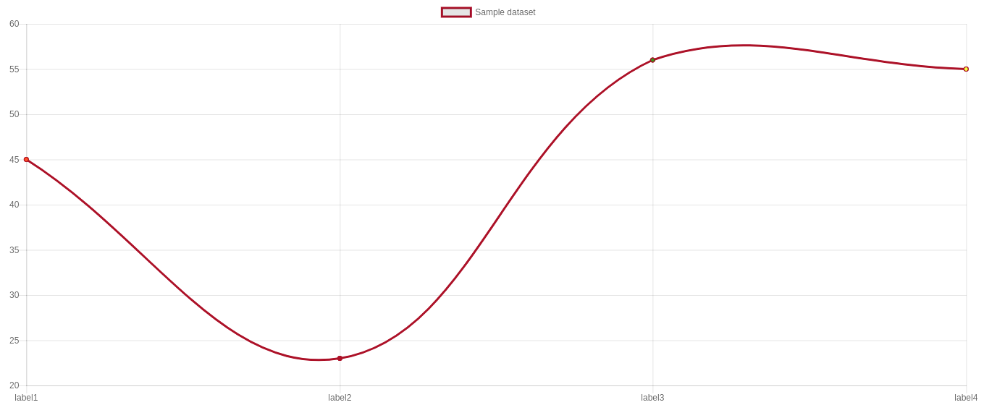

Malaria Detector
-
X
Train | Save Model | Load Model
Training Set
Add training set
Start Training
Validate Models
Error Rate Graph
Notification Bar

